Slide 1
Audio Classification
By
Sayed Khushal Shah (22)
&
Zeenat Tariq (20)

Slide 2








Technologies
Android
Scala
Spark
Python
Java
PyCharm
IntelliJ
Scikit-Learn
Numpy

Slide 3

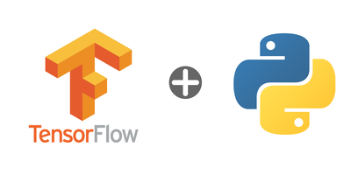
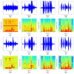


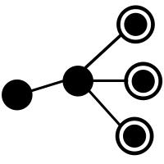
Motivation
Smart Hear is context aware android application for classification
Server configured in Spark
Shallow Learning techniques
5 main categories
Recognition
Audio Recording
Feature Extraction
Result Display

Slide 4
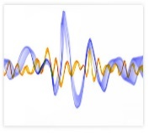
Work Flow
Training Model based on Algorithms
One hot Encoding
Training Data: 80%
Testing : 20%
Mel Frequency Cepstral Coefficients (MFCC), Chroma, Mel, Contrast and Tonnetz
Environmental Sound
Musical Data Set
Decision Tree, Random Forest, Naïve Bayes, CNN , ANN, LSTM,
(Auto Encoder)
Accuracy
Labelled
5. Learning Algorithm
1. Audio Data
4. Training Data
6. Train Model
3. Feature Engineering
2. Data Pre-Processing
8. Evaluate Model
5. Test Data
7. Labelled

Slide 5







Real Data flow
Real time Audio
data
Preprocessing
Features
New Data
Category
Classification

Slide 6
Algorithms
Spark
Tensor Flow
Random forest
Neural Network
Decision Tree
CNN
Auto-Encoder
Naïve Bayes
RNN-LSTM

Slide 7
Data
Environmental Data
Fire Crackling, Rooster, Chainsaw, Person sneezing, Clock Tick, Baby Cry, Sea Waves, Rain, Dog Bark, Helicopter
Audio Data
Environmental
6 Audio files
30 seconds each
Musical
10 Categories
Format
.ogg
10 Categories
Musical Data
Blues, Classical, Country, Disco, Hip hop, Jazz, Metal, Pop, Reggae, Rock
Format
.au
40 audio files
5 seconds each

Slide 8
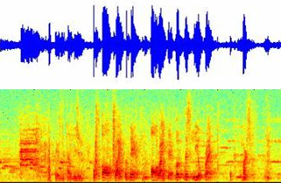


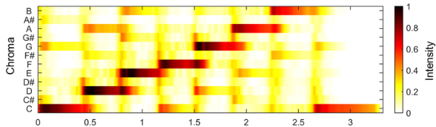
Features
Mel Frequency Cepstral Coefficients (MFCC)
Chroma
Mel
Contrast
Tonnetz

Slide 9

Results
LSTM has low accuracy due to the low data provided
Improved accuracy using Auto Encoder
High accuracy using Random Forest Algorithm
72%
87%
62%
Decision Tree
Random Forest
Naïve Bayes
78%
80%
70%
Neural Network
CNN
LSTM
82%
73%
Auto Encoder NN
Auto Encoder LSTM

Slide 10
Future Work
Improve Accuracy
Best Feature Selection
Applying Features on each Layer

Slide 11


